Slide 1
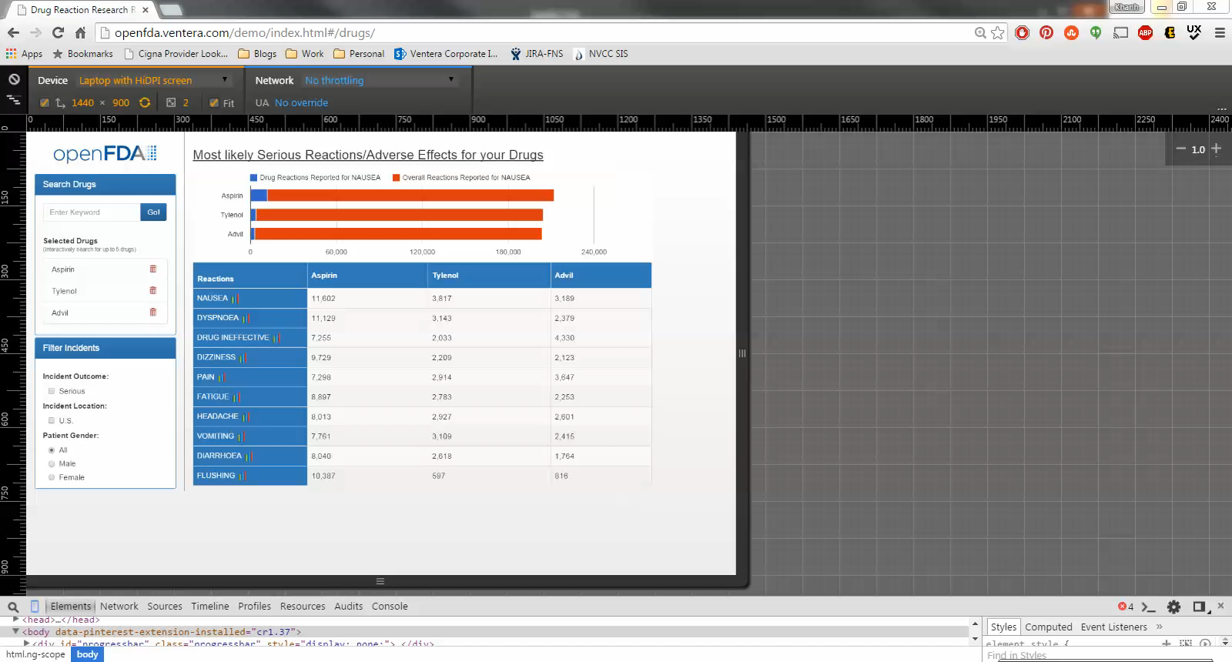
Drug Reactions Report - Responsive Design Video Note: Hover over image and click the Play button that appears at the bottom

